Slide 1
CS4200 Semester Project
Harrison Cajigal

Slide 2
RV32M Extension
mul
mulh
mulhu
mulhsu
div
divu
rem
remu

Slide 3
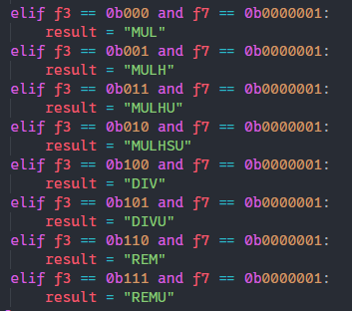
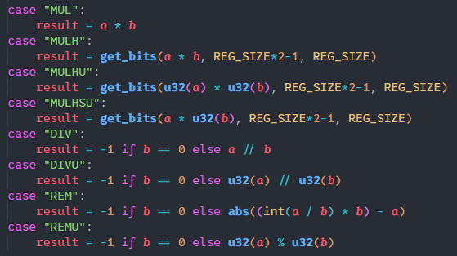
Implementation
Control
Execution

Slide 4
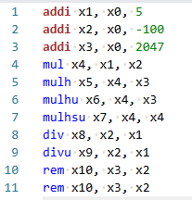
Test Input

Slide 5
Observations
Remainder != modulo

